Slide 1


Visualization and dimensionality reduction
Paweł Dąbrowski-Tumański
MiNI Lecture, Fall 2025

Slide 2

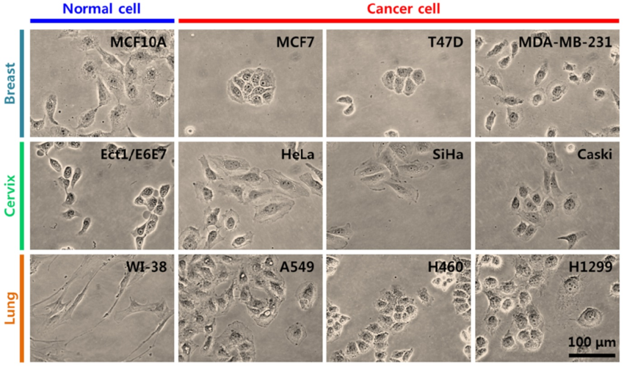
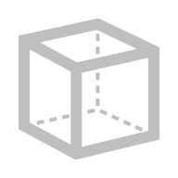






How distinguish single cel?
Kwon, S., Yang, W., Moon, D., & Kim, K. S. (2020). Comparison of cancer cell elasticity by cell type. Journal of Cancer, 11(18), 5403.
The cell state is defined by the type and amount of genes expressed
The problem is, there are around 20k genes which can be monitored.

Slide 3
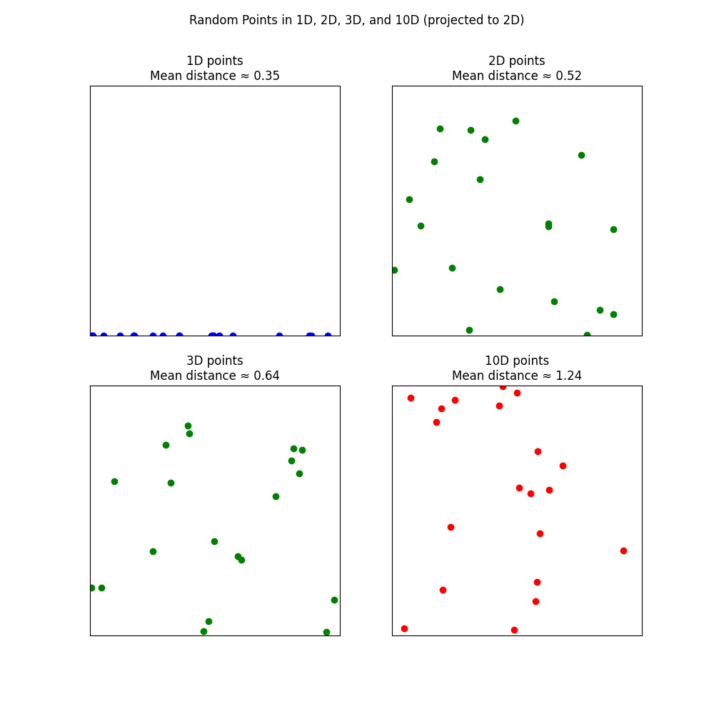
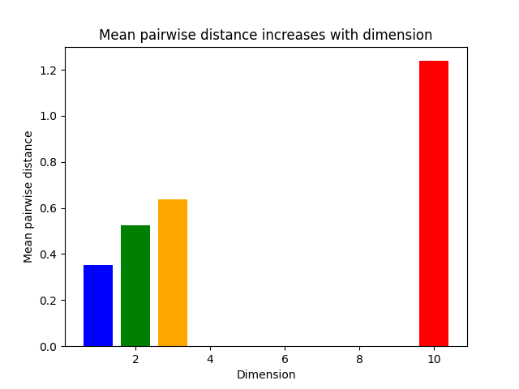
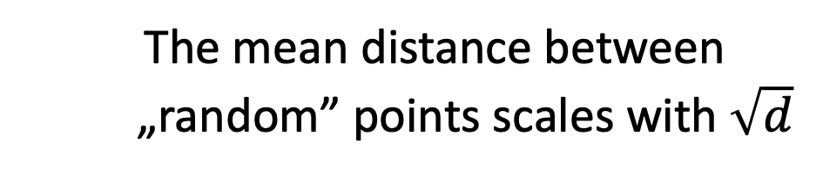
Problem of large dimension
With 20k dimensions it is unknown what is significant.
The mean distance between „random” points scales with $\sqrt{d}$

Slide 4
Biological motivation
♋ Clustering cancer types
🧪 Comparing drug effects
⚙️ Detecting batch effects
🧍‍♀️ Genome diversity
📊 Detecting outliers
🧠 Epigenetic patterns
🧫 Comparing tissues
🧩 Multi-omics integration

Slide 5

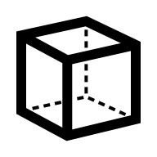

Principal Components Analysis
📏 Linear dimensionality reduction method
🧮 Find new uncorrelated variables
💡 Rotate the data axes so that the first axis (PC1) captures the most variance

Slide 6
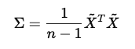
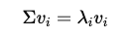
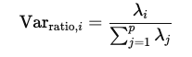
PCA - algorithm
🗂️ Standardize the data
💻 Compute covariance matrix
🔀 Eigen-decomposition / SVD
🤏 Sort components
🔀 Eigen-decomposition can be numericaly unstable, singular value decomposition may be better
🖥️ Project data

Slide 7
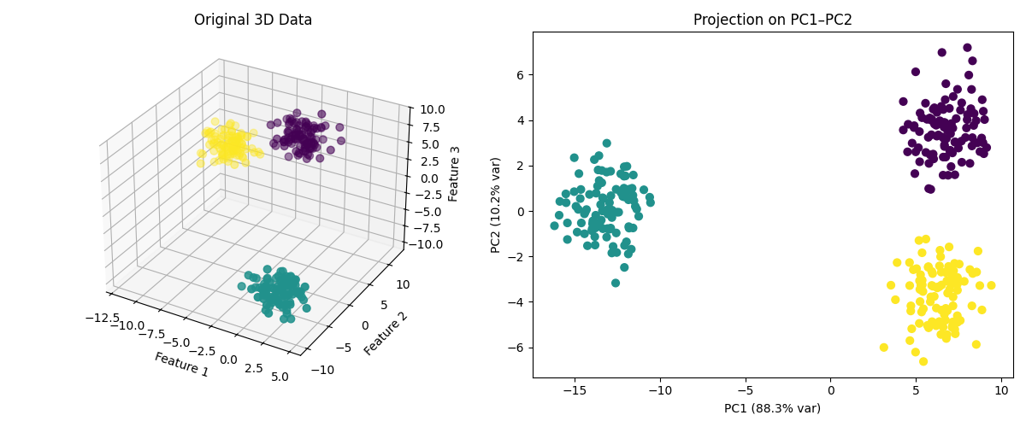
PCA - example

Slide 8
Need for non-linear methods
🔹Cannot capture nonlinear relationships
🔹Complex manifolds
🔹Clusters may be separable in curved space
🔹Important patterns in biology are usually nonlinear
🔹Variance-maximization may miss important details
🔹May require many components to campture nonlinearity

Slide 9
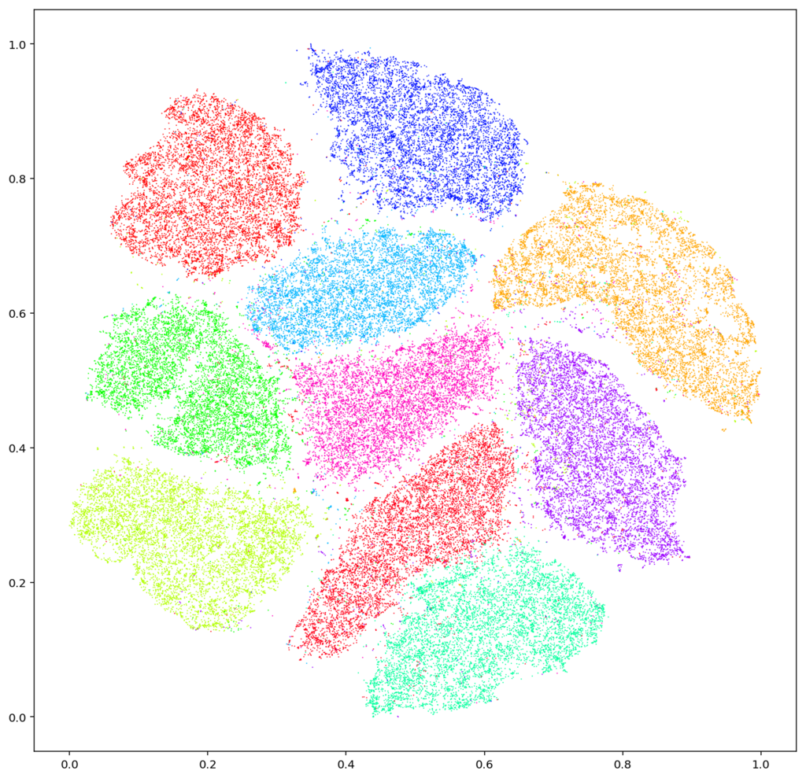
t-distributed Stochastic Neighbor Embedding
🌐 Non-linear method reducing dimension to 2 or 3
🧮 Converts pairwise distances into probabilities of similarity
💡 Preserves local structure

Slide 10
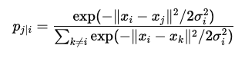
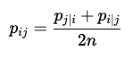
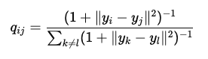
T-SNE algorithm
📏 Compute pairwise similarities in high-dimensional space
🪞 Symmetrize probabilities
⬇️ Map to low-dimensional space using t-distribution

Slide 11
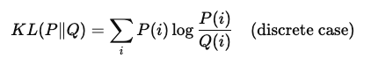
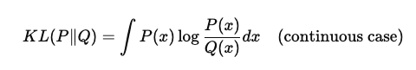
Kullback-Leibler divergence
📉 Minimize Kullback-Leibler divergence
🔹Measures “information loss” when $Q$ approximates $P$
📉 Minimize by gradient descent

Slide 12
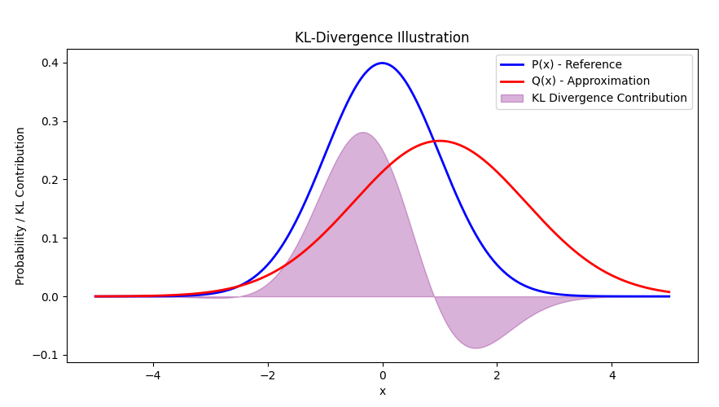
Kullback-Leibler divergence
KL(P || Q) ≈ 0.3499

Slide 13
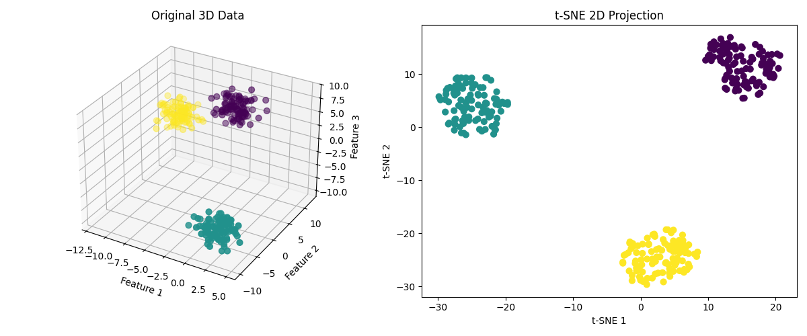
T-SNE example

Slide 14
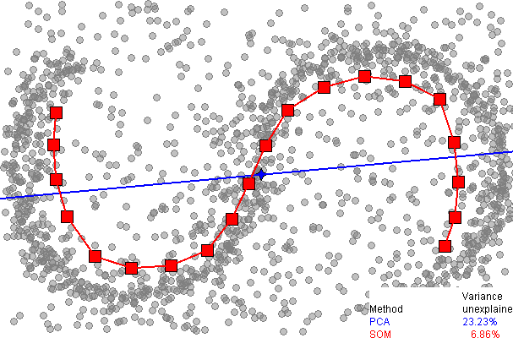
Uniform Manifold Approximation and Projection
🌐 Projects data maintaining manifold structure
🧮 Builds a weighted k-nearest neighbor graph in high-dimensional space
💡 Preserves both local and some global structure by approximating the manifold of the data

Slide 15
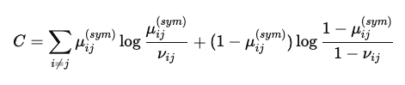
UMAP algorithm
🧼 Construct high-dimensional fuzzy simplicial set
🪞 Symmetrize graph
⬇️ Initialize low—dimensional embedding
📉 Optimize low-dimensional network via cross-entropy

Slide 16
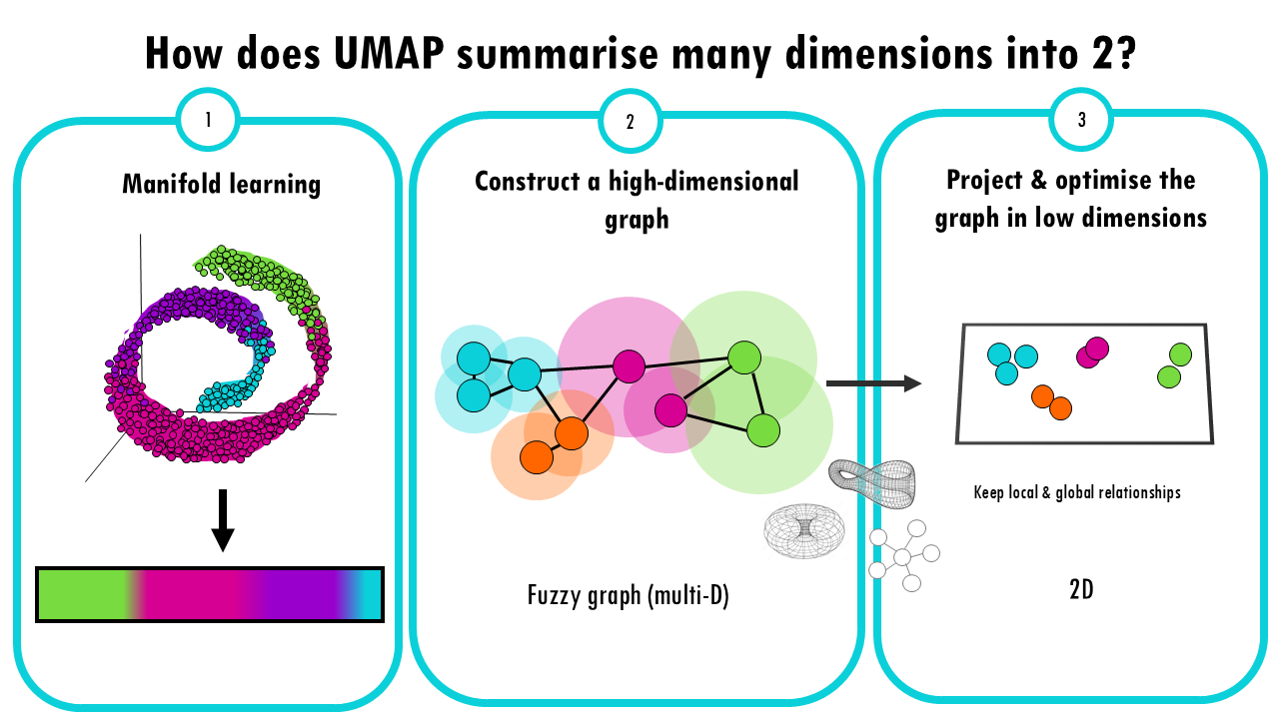
UMAP algorithm
https://biostatsquid.com/umap-simply-explained

Slide 17
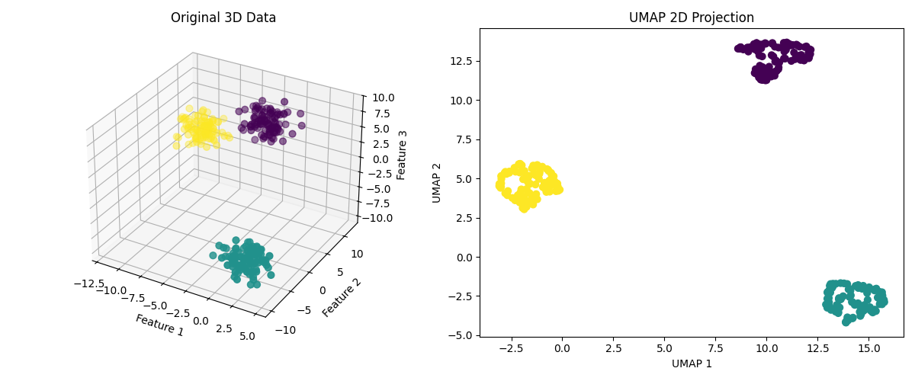
UMAP example

Slide 18
Method features
Feature | PCA | t-SNE | UMAP
Linear? | ✅ | ❌ | ❌
Global structure | ✅ | ❌ | ⚙️ partial
Local structure | ⚙️ moderate | ✅ | ✅
Interpretability | ✅ | ⚙️ limited | ⚙️ limited
Computation time | ⚡ fast | 🕒 slow | ⚡ fast

Slide 19
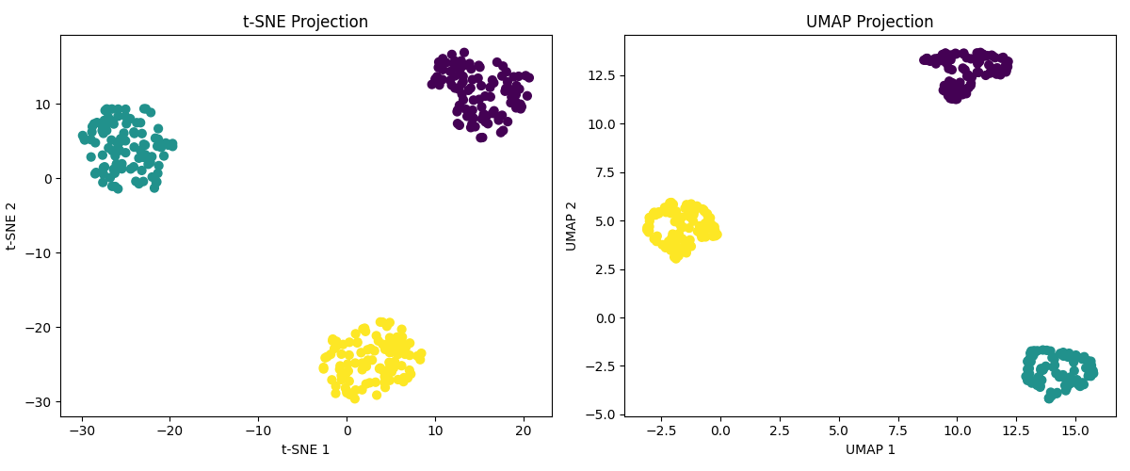
Method real comparison

Slide 20
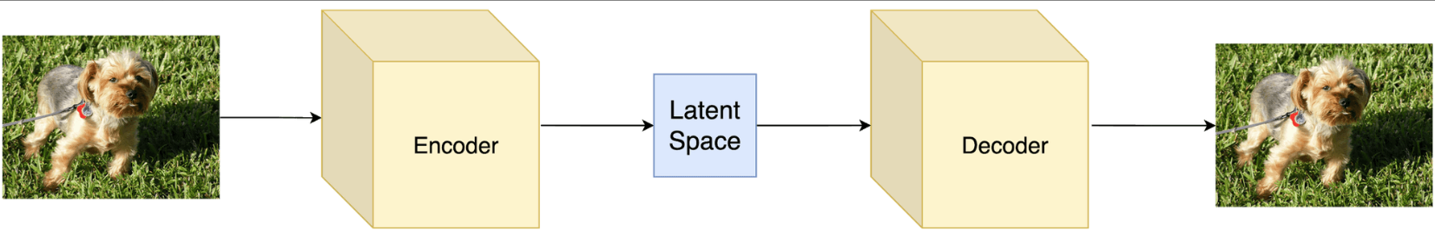
Autoencoders - theory
📉 Built with reconstruction loss = L2 distance
🗄️ Good for data compression

Slide 21
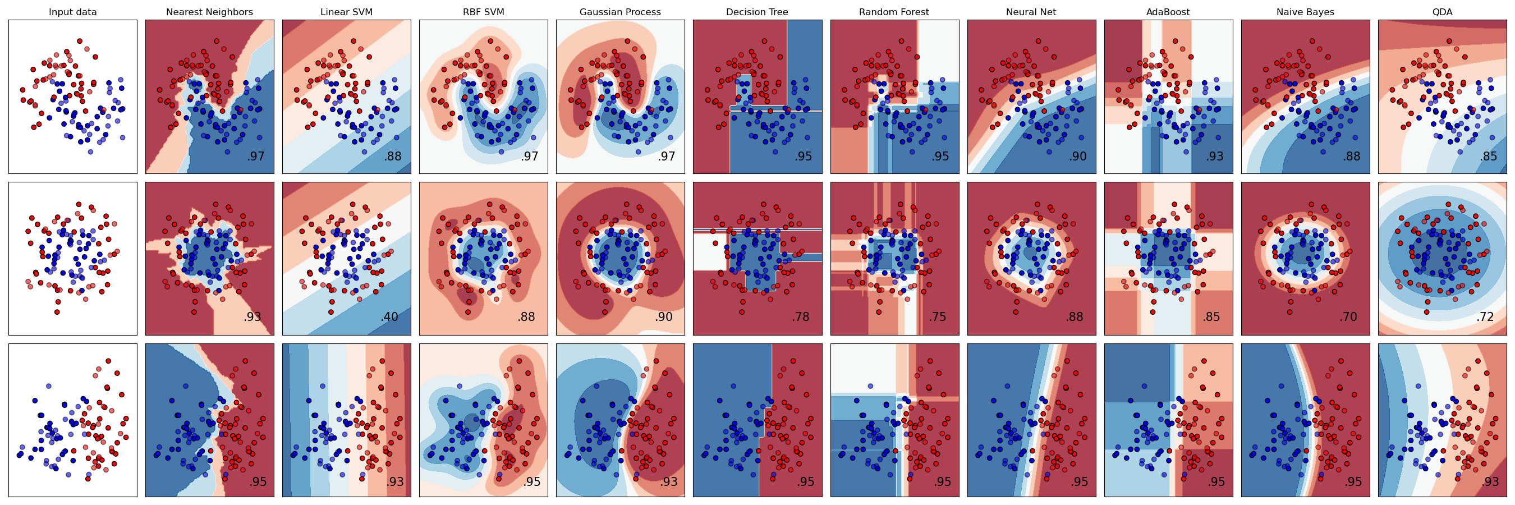

clustering algorithms
https://scikit-learn.org/stable/auto_examples/classification/plot_classifier_comparison.html

Slide 22
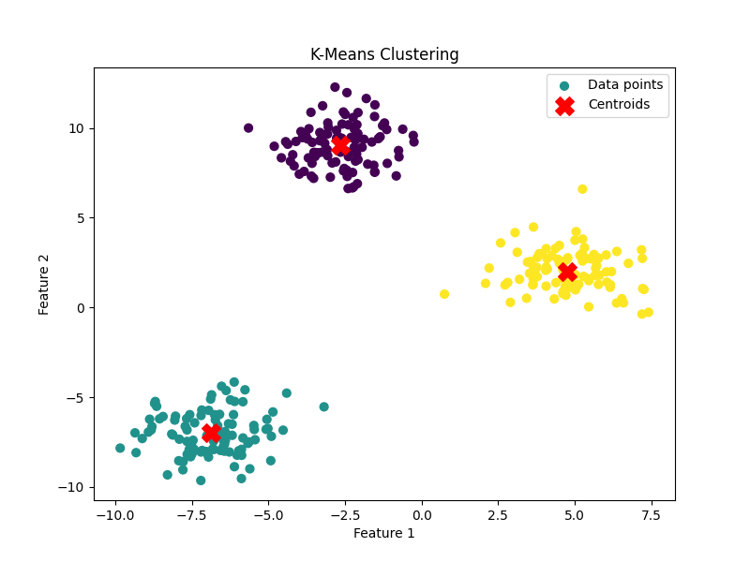
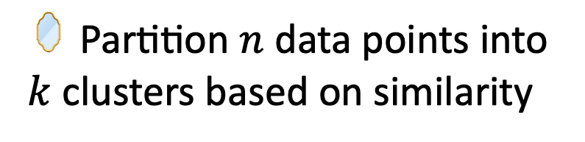
K-means clustering
🪞 Partition $n$ data points into $k$ clusters based on similarity
🧮 Objective function (minimize within-cluster variance)
💡 Each cluster is represented by a centroid; points are assigned to the closest centroid.

Slide 23
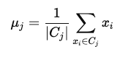
K-means clustering - algorithm
🎯Randomly select $k$ centroids $μ_{1},…,μ_{k}$
↙️ Assign each point $x_{i}$ to the nearest centroid
🎯 Compute new centroids as the mean of assigned points
🔄 Iterate assignment and update until convergence

Slide 24
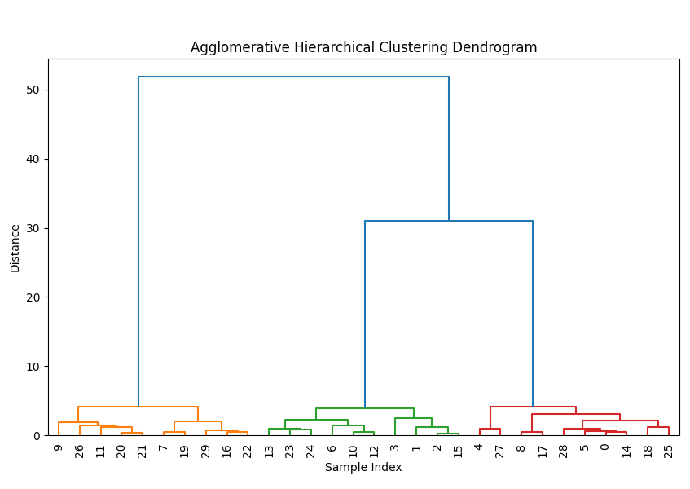
Hierarchical clustering
🔹Groups similar data points into a tree-like hierarchy
🔹No need to pre-specify the number of clusters
🔹Good for data with multi-level relationships
🔹Uses pairwise distances to define cluster similarity.

Slide 25
Aglomerative clustering
🎯 Treat each data point as a single cluster
📏 Compute pairwise distances between clusters
↔️ Merge the two closest clusters
🔄 Recompute distances between the new cluster and all others
🔄 Continue merging until all points are in a single cluster

Slide 26
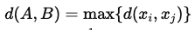
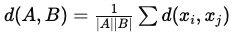
Linkage methods
1️⃣ Single linkage
2️⃣ Complete linkage
3️⃣ Average linkage

Slide 27
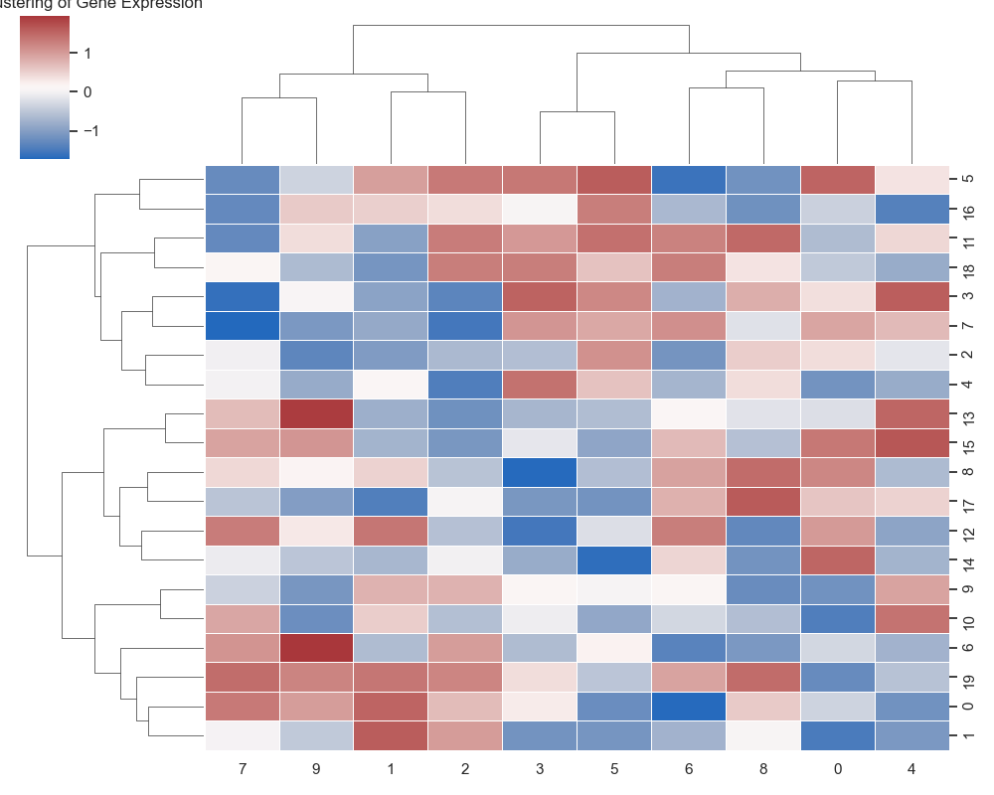
Dendrogram with heatmap

Slide 28
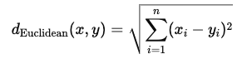
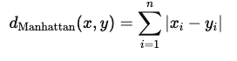
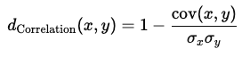
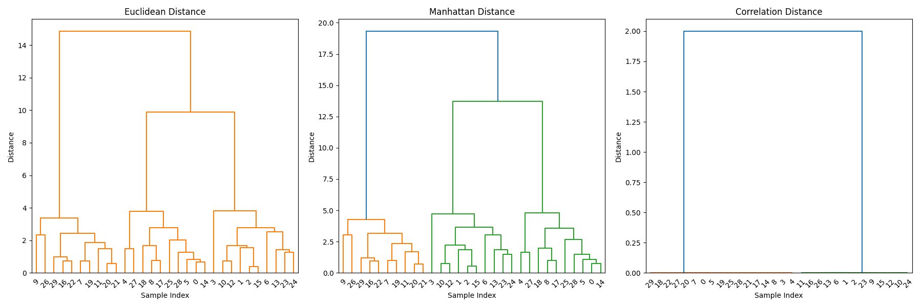
Distance metrics
1️⃣ Euclidean
2️⃣ Manhattan
3️⃣ Correlation distance

Slide 29
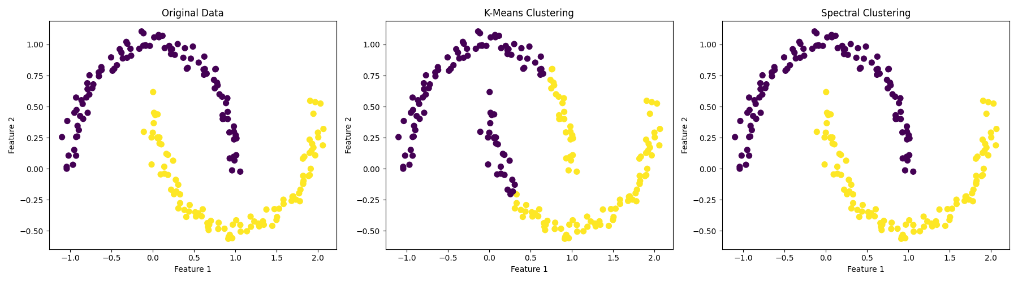
Spectral Clustering - theory
➡️ Cluster data using graph theory and similarity matrix
💡 Construct a graph where nodes = data points and edges = similarity
🧮 Use graph Laplacian eigenvectors to embed data into a lower-dimensional space

Slide 30
Spectral Clustering - algorithm
1️⃣ Compute similarity matrix $S$
2️⃣ Compute graph Laplacian
3️⃣ Compute eigenvectors
4️⃣ Embed data in spectral space
5️⃣ Cluster with k-means

Slide 31
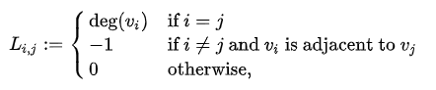
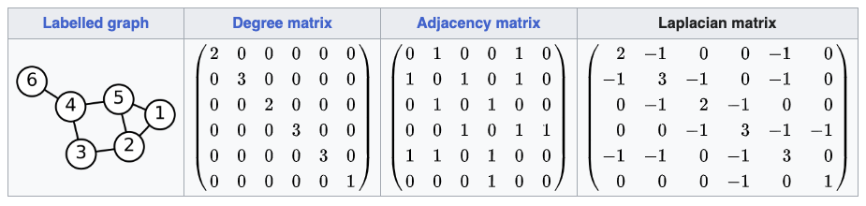
Graph laplacian

Slide 32
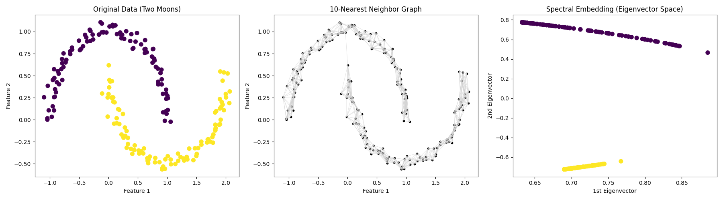
Spectral clustering – in spectral space

Slide 33
Batch effects
🔹 Systematic differences between datasets or batches
🔹 Different labs, sequencing runs, sample processing times
🔹 Samples cluster by batch instead of biological condition
🔹 Misleads dimensionality reduction
🔹 Combining multiple experiments becomes difficult.

Slide 34
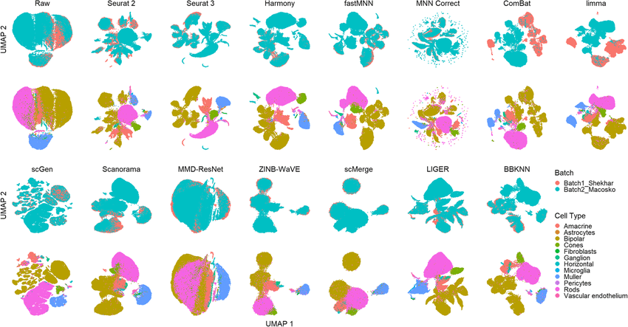
Batch effects - corrections
Tran, H. T. N., Ang, K. S., Chevrier, M., Zhang, X., Lee, N. Y. S., Goh, M., & Chen, J. (2020). A benchmark of batch-effect correction methods for single-cell RNA sequencing data. Genome biology, 21(1), 12.

Slide 35
Corrections - comparison
Method | Type / Approach | Main Features | Advantages
ComBat | 🔹Empirical Bayes, 🔹gene-level correction | 🔹Adjusts mean and variance of genes per batch; 🔹requires known batch labels | 🔹 Simple and widely used 🔹 Preserves biological signal across samples 🔹 Fast
Harmony | 🔹Embedding-based, 🔹iterative cluster alignment | 🔹Operates on low-dimensional embeddings (e.g., PCA); 🔹aligns shared clusters across batches | 🔹 Handles large single-cell datasets 🔹 Preserves local and global structure 🔹 Flexible for multiple batches
Seurat | 🔹Anchor-based, mutual nearest neighbors | 🔹Finds anchors between datasets; 🔹adjusts gene expression to create integrated dataset | 🔹 Handles heterogeneous cell types 🔹 Preserves shared biological structure 🔹 Widely adopted in scRNA-seq

Slide 36
Corrections – Limitation and use cases
Method | Limitations | Typical Use-Cases
ComBat | 🔹 Assumes additive/multiplicative batch effects 🔹 Limited for highly heterogeneous single-cell data | 🔹Microarray / bulk RNA-seq, 🔹small batch correction
Harmony | 🔹 Requires embedding (e.g., PCA) as input 🔹 Sensitive to clustering and dimensionality parameters | 🔹Single-cell RNA-seq, 🔹multi-batch integration, 🔹trajectory analysis
Seurat | 🔹 Computationally intensive for large datasets 🔹 Sensitive to anchor selection and preprocessing | 🔹Single-cell RNA-seq, 🔹dataset merging, 🔹integration of multi-condition experiments

Slide 37
Cluster validation
🔹 Goal: Evaluate quality and validity of clustering results.
🔹 Clustering is unsupervised — no labels to verify accuracy.
🔹 Assessing compactness, separation, and cluster stability.
🔹 Internal validation: Uses data and cluster labels.
🔹 External validation: Compares clustering to known labels.

Slide 38
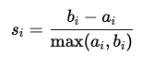
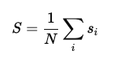
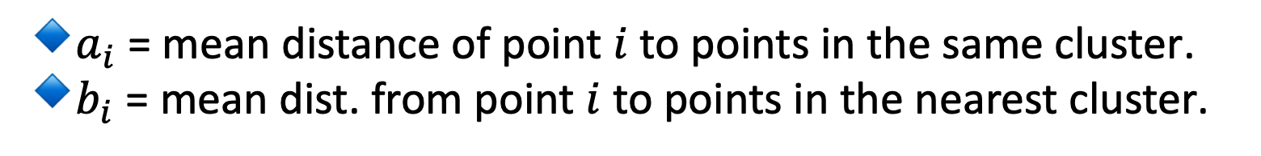
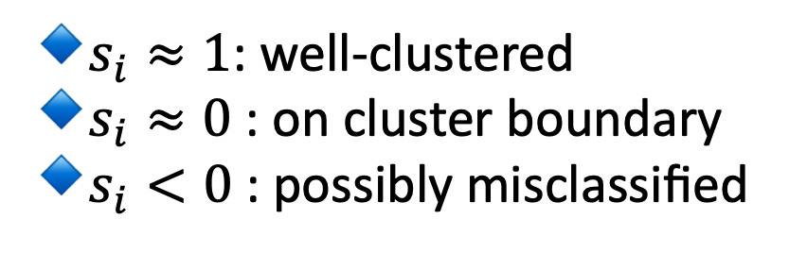
Silhouette score
💡 Measures how similar each point is to its own cluster compared to other clusters.
🔹​$a_{i}$ = mean distance of point $i$ to points in the same cluster.
🔹​$b_{i}$ = mean dist. from point $i$ to points in the nearest cluster.
🔹$s_{i}≈1$: well-clustered
🔹​$s_{i}≈0$: on cluster boundary
🔹$s_{i}<0$: possibly misclassified
📊 Overal score

Slide 39
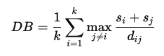
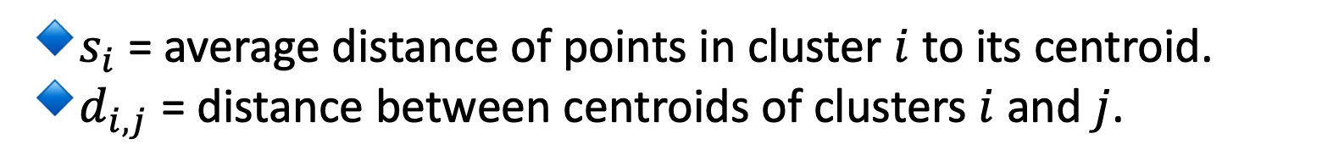
Davis-Bouldin index
💡 Average “similarity” between clusters — ratio of within-cluster scatter to between-cluster separation.
🔹​$s_{i}$ = average distance of points in cluster $i$ to its centroid.
🔹​$d_{i,j}$ = distance between centroids of clusters $i$ and $j$.
🎯 Lower DBI → better clustering (compact, well-separated clusters)

Slide 40
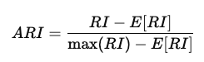
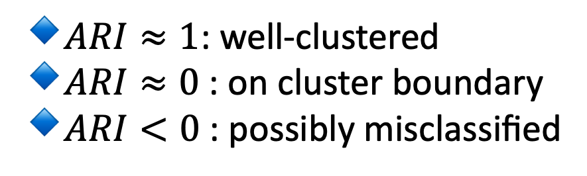
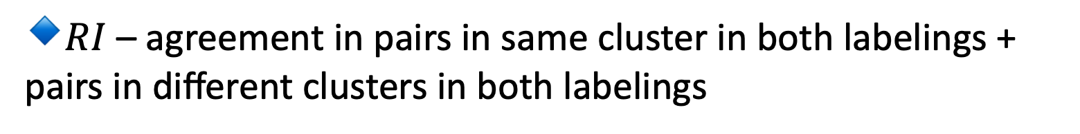
Adjusted Rand Index
💡 Measures similarity between predicted clusters and ground truth labels, adjusted for random chance.
🔹​$RI$ – agreement in pairs in same cluster in both labelings +
pairs in different clusters in both labelings
🔹$ARI≈1$: well-clustered
🔹​$ARI≈0$: on cluster boundary
🔹$ARI<0$: possibly misclassified

Slide 41




Mutual information
💡 Measures shared information between predicted clusters $C$ and true labels $T$.
🔹​${p(c}_{i},t_{j})$ = joint probability of cluster $i$ and true class $j$.
🔹​${p(c}_{i})$, ${p(t}_{j})$ = marginal probabilities
🔹$MI≈1$: well-clustered
🔹​$MI≈0$: poorly clastered

Slide 42
Cluster validation - comparison
Metric | Type | Range | High = Good? | Intuition
Silhouette Score | Internal | -1 → 1 | ✅ | Compact + separated clusters
Davies–Bouldin Index | Internal | ≥ 0 | ❌ (Lower better) | Ratio of scatter vs. separation
Adjusted Rand Index (ARI) | External | -1 → 1 | ✅ | Agreement with true labels
Mutual Information (NMI) | External | 0 → 1 | ✅ | Shared information between cluster and labels

Slide 43

Cluster validation - comparison
K-Means Spectral Clustering
Silhouette 0.488 0.331
Davies-Bouldin 0.779 1.152
ARI 0.247 1.000
NMI 0.189 1.000

Slide 44
Python-based tools
Goal | Recommended Tools | Why
Linear reduction / visualization | PCA from sklearn, scanpy.pp.pca | Fast, interpretable, often first step.
Non-linear manifold learning | umap-learn, OpenTSNE | Captures complex biological trajectories.
Batch correction & data integration | harmonypy, scanpy.pp.combat, Seurat interface | Removes technical variation before clustering.
Clustering heterogeneous data | Leiden/Louvain (Scanpy), HDBSCAN, SpectralClustering | Detects variable cluster shapes and sizes.
Validation & visualization | sklearn.metrics, Yellowbrick | Compute ARI, NMI, Silhouette, DBI, visualize cluster structure.

Slide 45
Python-based tools
Library / Tool | Category | Main Features & Advantages | Typical Use-Cases
scikit-learn (sklearn) | ✅ General ML / Clustering / DR | - Implements PCA, KernelPCA, t-SNE, Spectral Clustering, K-Means, Agglomerative, DBSCAN, etc.- Simple API, well-documented, integrates with pipelines. | - General-purpose ML- Exploratory clustering- Dimensionality reduction (PCA/t-SNE)- Baseline comparisons
umap-learn | ✅ Non-linear Dimensionality Reduction | - Efficient implementation of UMAP.- Preserves global + local structure.- Scales to large datasets. | - scRNA-seq visualization- Manifold learning- Feature extraction before clustering
scanpy | 🧬 Single-cell Omics Framework | - Built on top of AnnData.- Integrates PCA, UMAP, t-SNE, Leiden/Louvain clustering, batch correction.- Interoperable with Seurat (R). | - Single-cell RNA-seq data analysis- Integration + visualization pipelines

Slide 46
Python-based tools
Library / Tool | Category | Main Features & Advantages | Typical Use-Cases
harmony-pytorch / harmonypy | 🧩 Batch Correction + Integration | - Implements Harmony algorithm.- Integrates datasets while preserving biological signal.- Compatible with scanpy and AnnData. | - Multi-batch single-cell integration- Removing technical variability before clustering
combat.py (in pyComBat, neuroCombat, or scanpy.pp.combat) | ⚙️ Batch Effect Correction | - Implements ComBat method.- Fast adjustment of gene-level mean/variance.- Integrated into scanpy and neuroimaging workflows. | - Bulk RNA-seq normalization- Removing batch bias in omics or imaging data
SeuratDisk / scVI / scArches (Python interfaces) | 🧬 Deep Learning–Based Integration | - Handles complex single-cell datasets.- Learns latent representation shared across datasets.- Can model batch + modality effects. | - Multi-modal single-cell data integration- Transfer learning and atlas mapping

Slide 47
Python-based tools
Library / Tool | Category | Main Features & Advantages | Typical Use-Cases
hdbscan | 🔍 Density-Based Clustering | - Extension of DBSCAN.- Detects variable-density clusters.- Assigns soft probabilities (outlier detection). | - scRNA-seq population discovery- High-dimensional, noisy data clustering
MiniBatchKMeans (sklearn) | ⚡ Scalable K-Means | - Efficient for large datasets.- Incremental updates.- Compatible with streaming data. | - Quick clustering for large-scale embeddings (e.g., UMAP outputs)
PyClustering | 🔢 Classic + Graph-Based Clustering | - Offers CURE, BIRCH, OPTICS, K-Medoids, etc.- Includes visualization tools. | - Exploring alternative clustering strategies- Graph or hierarchical clustering research

Slide 48
Python-based tools
Library / Tool | Category | Main Features & Advantages | Typical Use-Cases
TensorFlow / PyTorch | 🤖 Deep Learning Representations | - Build autoencoders, VAEs, contrastive embeddings.- Learn latent spaces for DR + clustering. | - Deep dimensionality reduction- Multi-omics representation learning
OpenTSNE | 🌀 Optimized t-SNE Implementation | - Faster, memory-efficient t-SNE.- Supports incremental learning, partial fits.- Integrates with scanpy and sklearn. | - Visualization of complex manifolds- scRNA-seq / cytometry datasets
Yellowbrick | 📊 Model Visualization | - Diagnostic tools for clustering validation (Silhouette, elbow plots). | - Teaching, model evaluation, reporting clustering quality

Slide 49



Mind the variance
Explained variance in DUDe dataset
(molecules inhibiting ERK2 protein)

Slide 50


Do you see clusters? Recalculate
💡 Perplexity can be interpreted as “expected number of close neighbors” for each point
🧮 Related to the variance of the Gaussian kernel used to compute pairwise similarities in high-dimensional space.

Slide 51


Do you see clusters? Recalculate
https://distill.pub/2016/misread-tsne

Slide 52


Don’t believe the distances
https://distill.pub/2016/misread-tsne

Slide 53


Spatial distribution can be misleading
https://distill.pub/2016/misread-tsne

Slide 54


Cell types
Sześcian

Slide 55

Tumor type
Sześcian
Gustafsson, J., Anton, M., Roshanzamir, F., Jörnsten, R., Kerkhoven, E. J., Robinson, J. L., & Nielsen, J. (2023). Generation and analysis of context-specific genome-scale metabolic models derived from single-cell RNA-Seq data. Proceedings of the National Academy of Sciences, 120(6), e2217868120.

Slide 56


scGPT
Sześcian
🔹cell classification
🔹​unseen gene perturbation responses

Slide 57

Visualizing chemical space
Sześcian
Huang, X., Ma, S., Zhao, C. Y., Wang, H., & Ju, S. (2023). Exploring high thermal conductivity polymers via interpretable machine learning with physical descriptors. npj Computational Materials, 9(1), 191.

Slide 58

Train/test split
Sześcian

Slide 59





Wrap-Up
There are at least three methods for dimensionality reduction: PCA, t-SNE and UMAP
After dimension reduction, cluster data and assess its claster quality. Mind batch effects
The tools might be used in bioinformatics, cheminformatics and plain ML.
Keep in mind data variance and that you might be mislead by clusters

